Slide 1

Exploratory Analysis on Parch & Posey Data
Presented By Data Ninjas
Chisom Nnamani
Sanyaolu Adefemi
Olubusayo Alese
Date: 04/09/2024

Slide 2

Content
1 | Overview
2 | Findings
3 | Summary of Insights
4 | Conclusion

Slide 3

Overview
Five datasets (orders, web-events, accounts, sales_rep and region) were provided and integrated into the PostgreSQL database.
These data are to be explored to provide insights on Parch & Posey’s data.

Slide 4
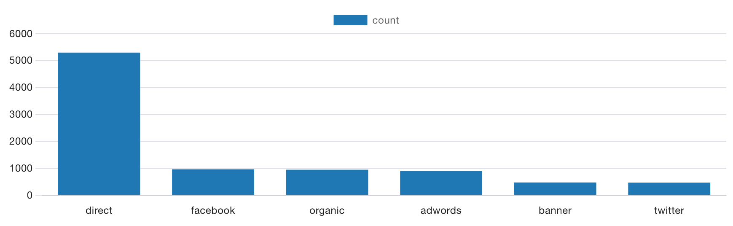
Findings
Query:
SELECT channel, COUNT(channel)
FROM web_events
GROUP BY channel
ORDER BY 2 DESC;
Customer Traffic Sources

Slide 5
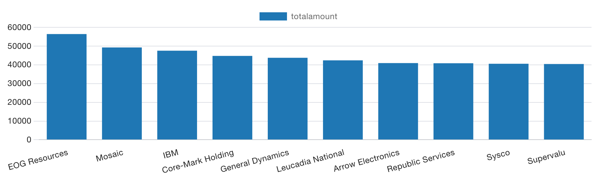
Findings
Query:
SELECT accounts.name, SUM(total) as totalAmount
FROM accounts
JOIN orders
ON orders.account_id = accounts.id
GROUP BY accounts.name
ORDER BY totalAmount DESC
LIMIT 10;
Top Ten Customers Based on Sales

Slide 6
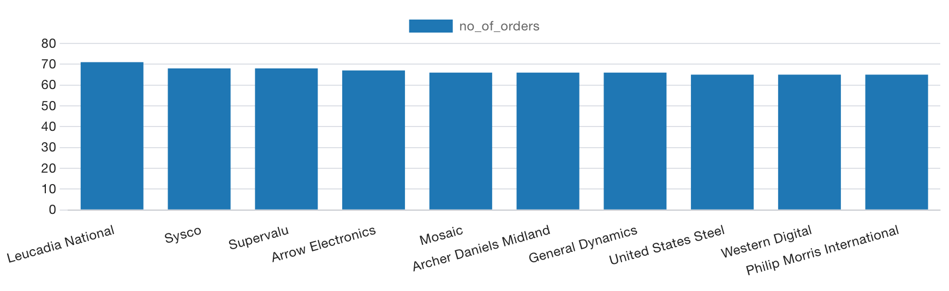
Findings
Query:
SELECT accounts.name, count(orders.id) as no_of_orders
FROM accounts
JOIN orders
ON orders.account_id = accounts.id
GROUP BY accounts.name
ORDER BY no_of_orders DESC
LIMIT 10;
Top Ten Customers Based on Orders

Slide 7
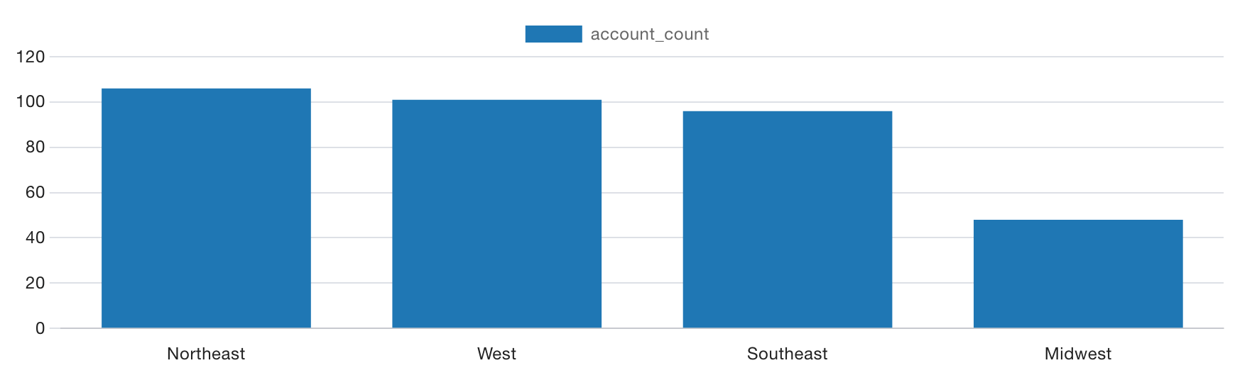
Findings
Query:
SELECT COUNT(accounts.name) AS account_count, region.name AS region
FROM accounts
JOIN sales_reps
ON sales_reps.id = accounts.sales_rep_id
JOIN region
ON region.id = sales_reps.region_id
GROUP BY region
ORDER BY account_count DESC;
Geographical Distribution of Posey Customers

Slide 8
Summary
Traffic Sources: Direct source has the highest traffic which may indicate a strong brand reputation, high referrals.
EOG Resources is Posey’s customer with highest sales amount (over 50,000 USD) whilst Leucadia National is Posey’s customer with the highest number of orders placed (about 70 orders).
Midwest region is the region with the lowest number of customers whilst Northeast region has the highest number of customers.

